Slide 1


ETUM
ELECTRONIC TOILET USAGE MONITORING

Slide 2
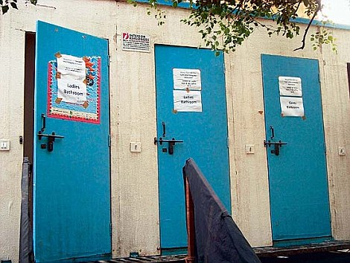
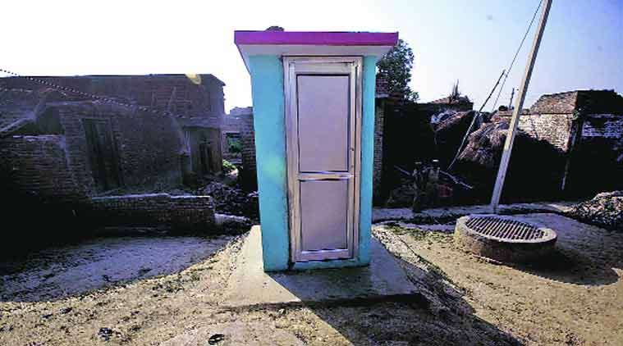
ETUM
The government has made Millions of toilet for a clean India under the Swachh Bbharat Ahiyaan.
To have a effective usage of these toilets, we have developed ETUM.

Slide 3
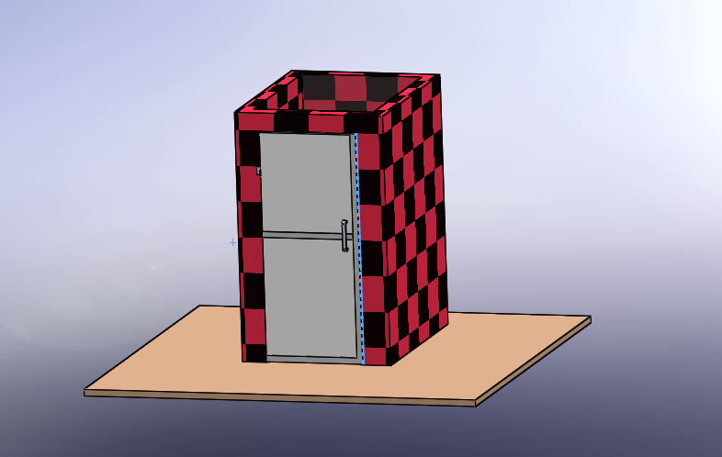
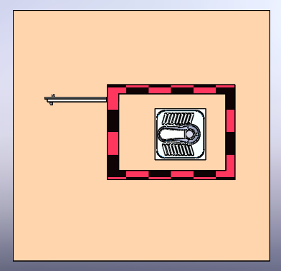
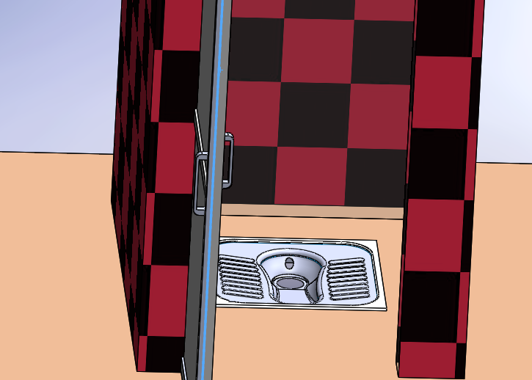
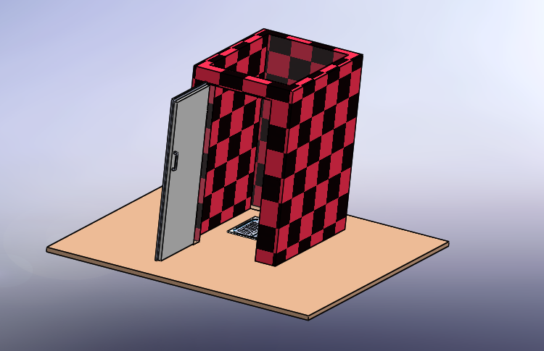
ETUM WORKING`
ETUM
We have considered a standard
0.8 x1x1.9 m toilet room.

Slide 4
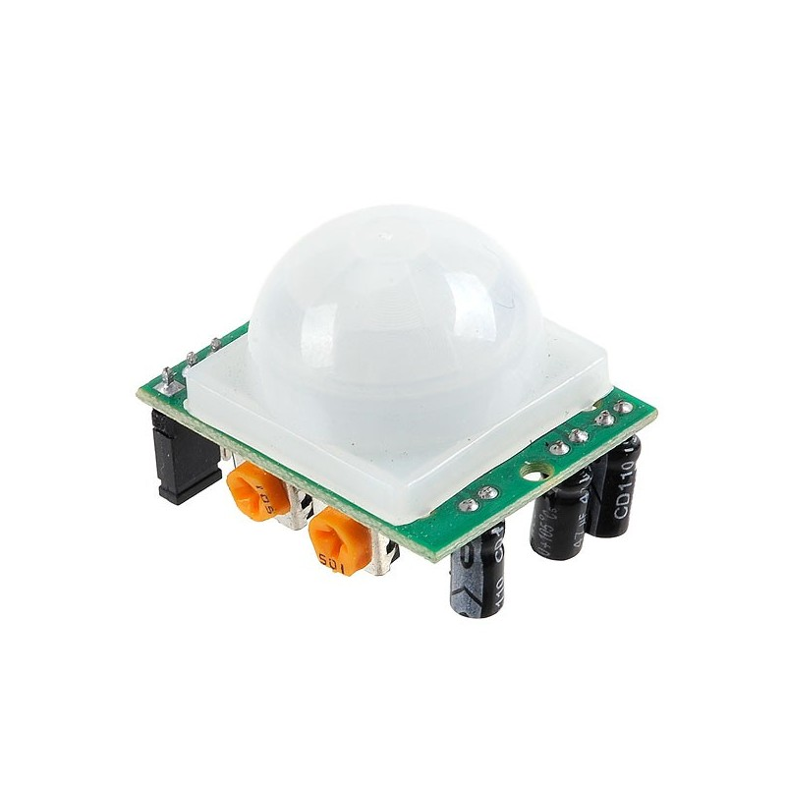
PIR SENSOR
ETUM
PIR sensors allow you to sense motion, almost always used to detect whether a human has moved in or out of the sensors range. They are small, inexpensive, low-power, easy to use and don't wear out. For that reason they are commonly found in appliances and gadgets used in homes or businesses. They are often referred to as PIR, "Passive Infrared", "Pyroelectric", or "IR motion" sensors.

Slide 5
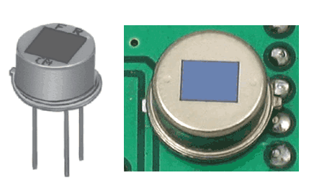
PIR SENSOR
ETUM
PIRs are basically made of a pyroelectric sensor (which you can see above as the round metal can with a rectangular crystal in the center), which can detect levels of infrared radiation. Everything emits some low level radiation, and the hotter something is, the more radiation is emitted. The sensor in a motion detector is actually split in two halves. The reason for that is that we are looking to detect motion (change) not average IR levels. The two halves are wired up so that they cancel each other out. If one half sees more or less IR radiation than the other, the output will swing high or low.

Slide 6
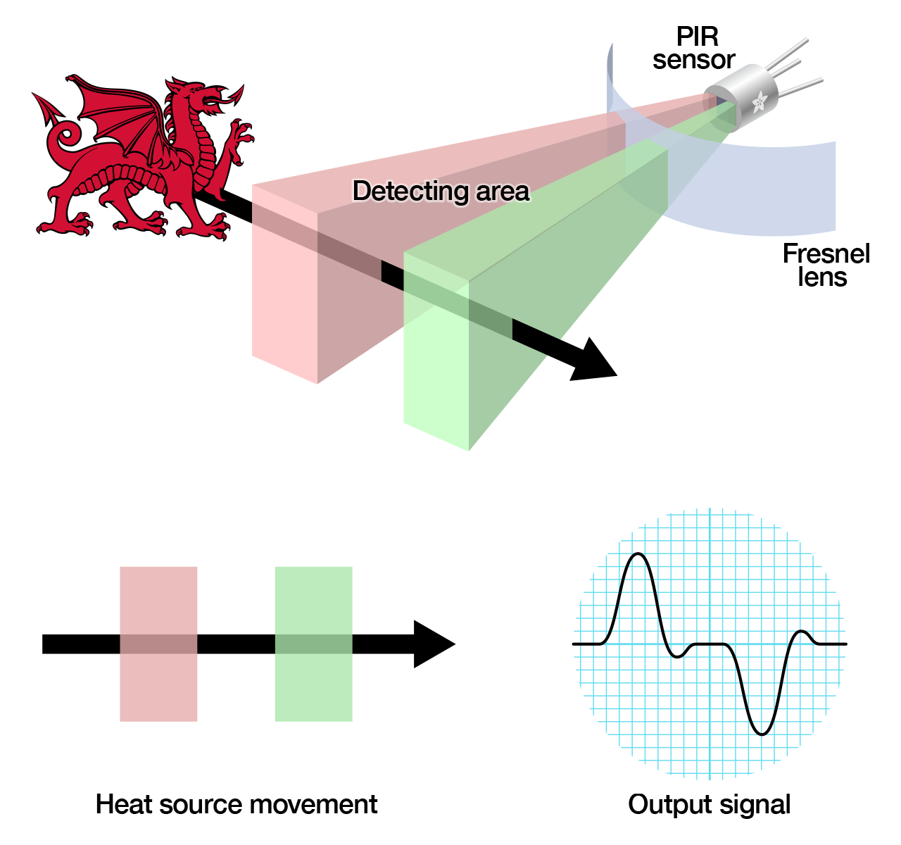
PIR SENSOR WORKING
ETUM
The PIR sensor itself has two slots in it, each slot is made of a special material that is sensitive to IR. When the sensor is idle, both slots detect the same amount of IR, the ambient amount radiated from the room or walls or outdoors. When a warm body like a human or animal passes by, it first intercepts one half of the PIR sensor, which causes a positive differential change between the two halves. When the warm body leaves the sensing area, the reverse happens, whereby the sensor generates a negative differential change. These change pulses are what is detected.
​

Slide 7
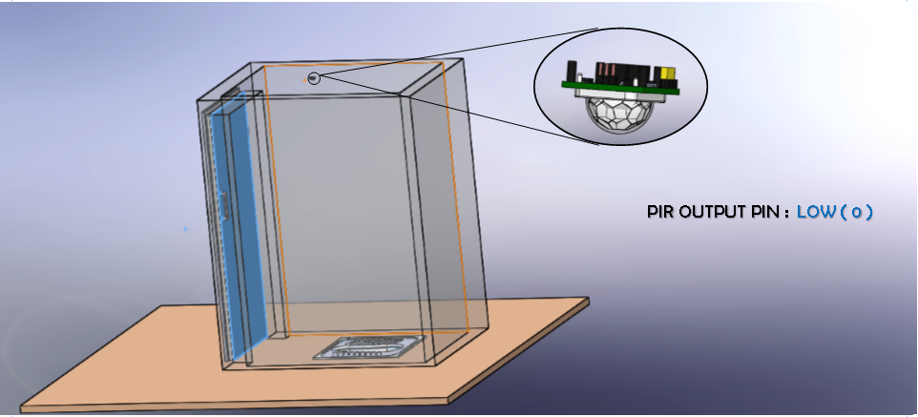
ETUM WORKING
When the toilet is not being used,
the sensor reads low.

Slide 8
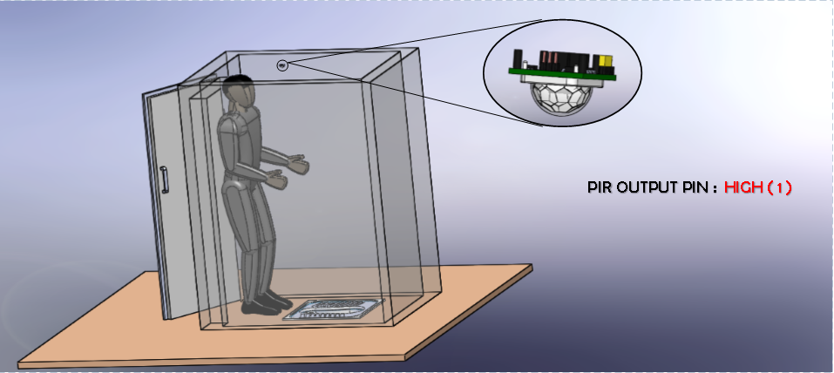
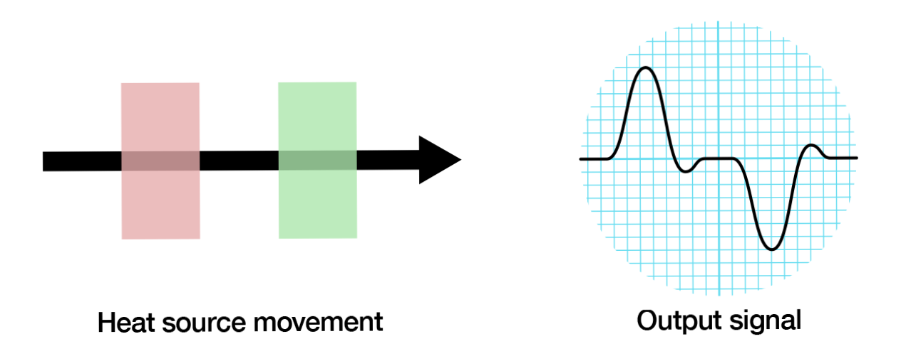
ETUM WORKING
As soon as a person enters into the toilet,
The sensor reads high for a small duration of
About 2 to 3 seconds and comes back to low.

Slide 9
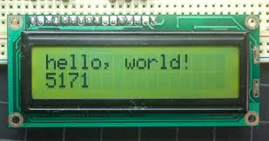
ETUM IDEA
The device works on the principle of infrared rays detection by a PIR sensor.
The device is designed to work continuously for about 5 months without any
maintenance in between.
After duration of these 5 months, a person will have to record the data that
Is stored in these 5 months by plugging in an LCD screen into the LCD pins
Provided in ETUM.
A Standard 16x2 LCD screen.

Slide 10
ETUM IDEA
We instead of using a standard HC-SR501, have designed our own PCB module removing the unnecessary voltage
Regulator and potentiometer for minimum power dissipation. We in the PCB we have added a
microcontroller(ATTINY 24A) for the processing of the data along with separate pins in which the LCD has to be
Plugged-in to read the data. A battery of 3000mAh is used in the device.
Here is a list of the components used in the device:-
Resistor(ohms)
47k -1
6.8k -1
2k -1
10k -5
18k -3
470k -1
1M -3
1k -1
3000mAh
Rechargeable battery 1
Capacitor
5nF -1
47uF -1
22uF -2
100nF -2
10nF -5
ICs and PIR
ATTINY 24A
BISS0001 SMD
RE200B

Slide 11
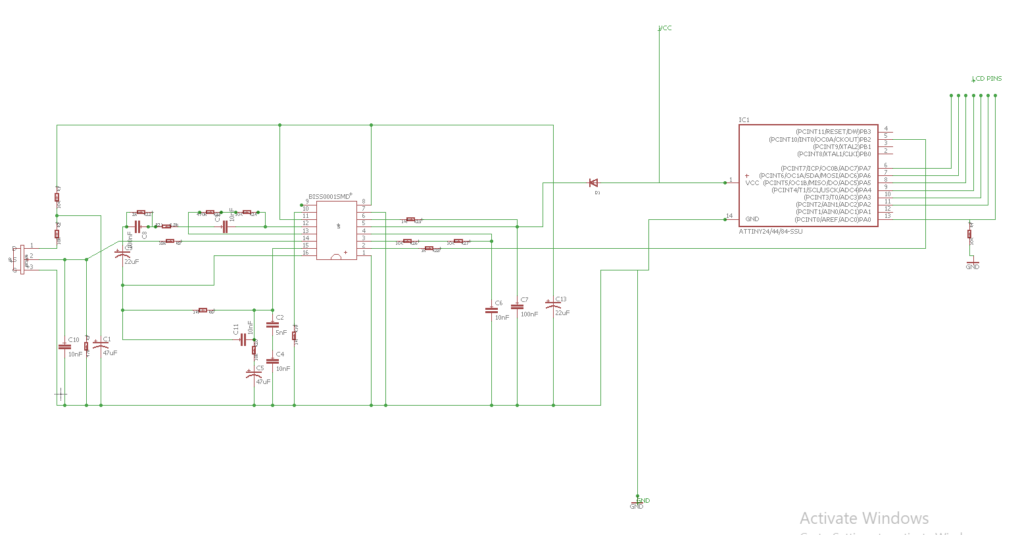
ETUM PCB SCHEMATIC

Slide 12
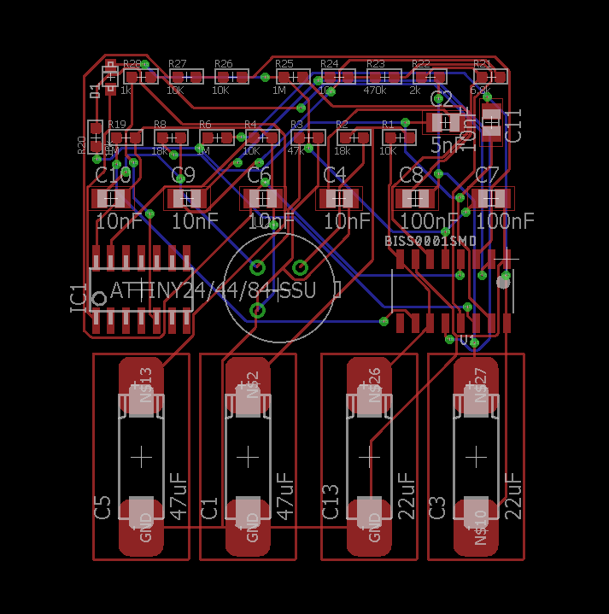
ETUM PCB BOARD
PCB design of ETUM

Slide 13
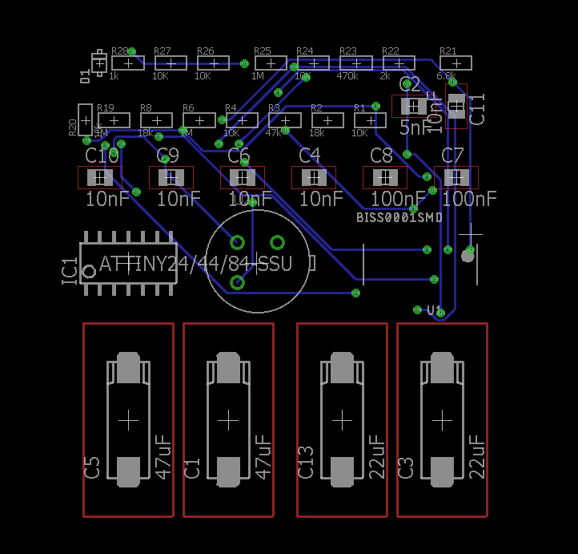
ETUM PCB BOARD
Bottom layer of PCB.

Slide 14
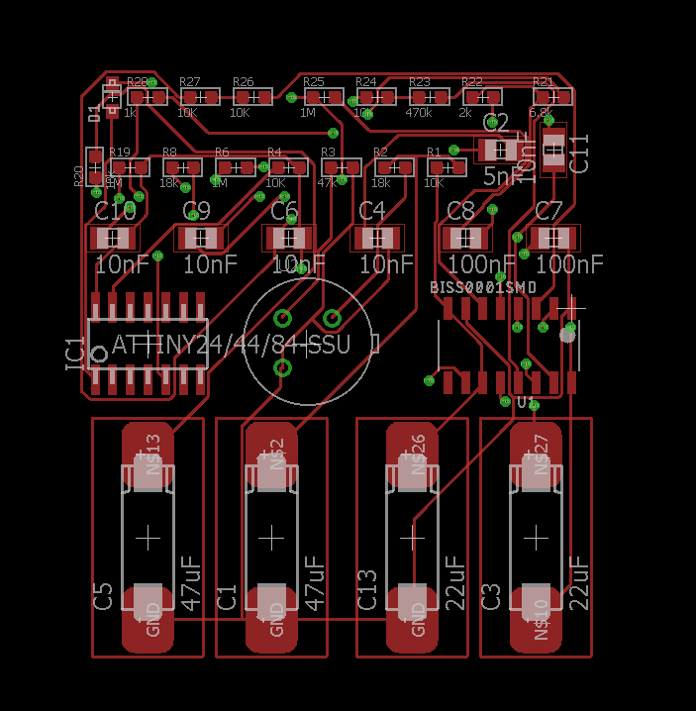
ETUM PCB BOARD
Top layer of PCB

Slide 15
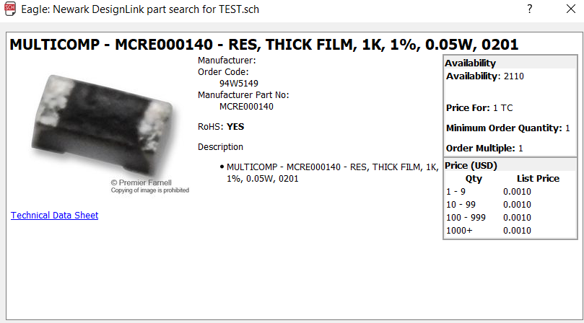
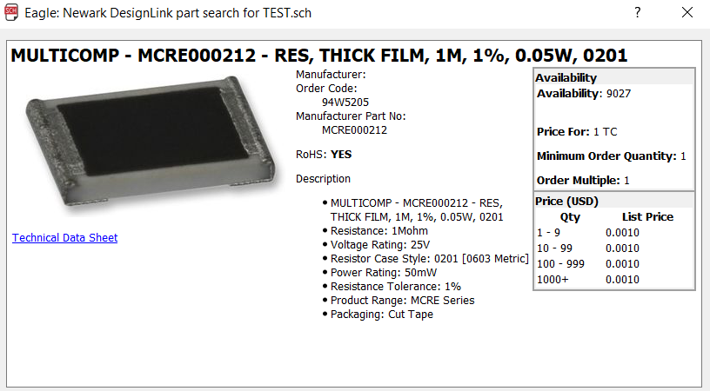
COST in ETUM manufacturing.
1K resistor cost= 0.001
1M resistor cost= 0.001

Slide 16
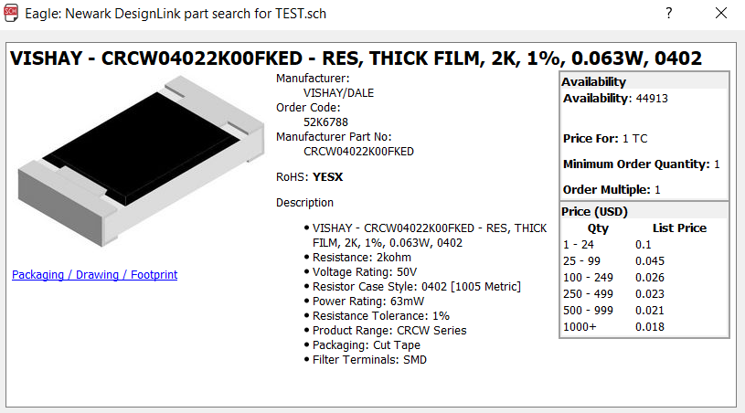
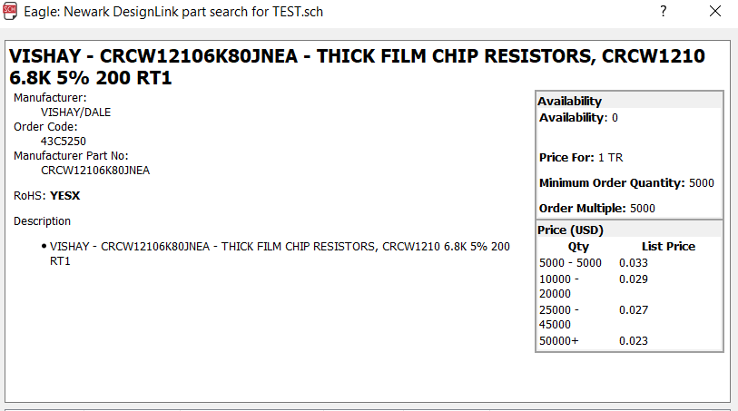
COST in ETUM manufacturing.
2K resistor cost= 0.018
6.8K resistor cost= 0.023

Slide 17

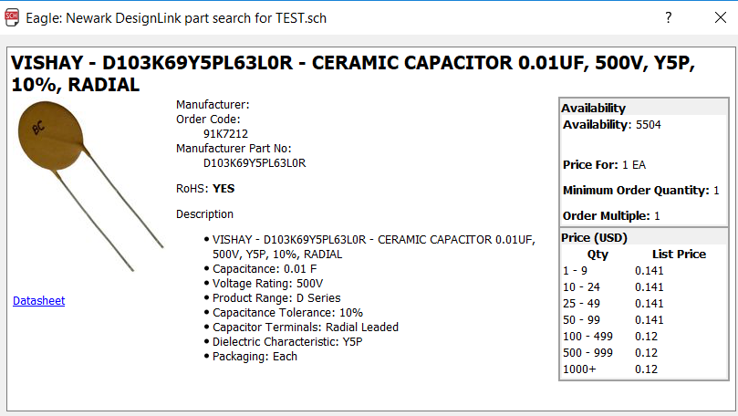
COST in ETUM manufacturing.
10K resistor cost= 0.001
0.01uF capacitor cost= 0.12

Slide 18
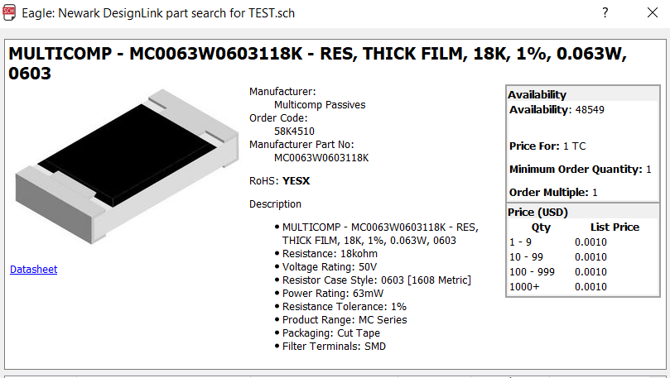
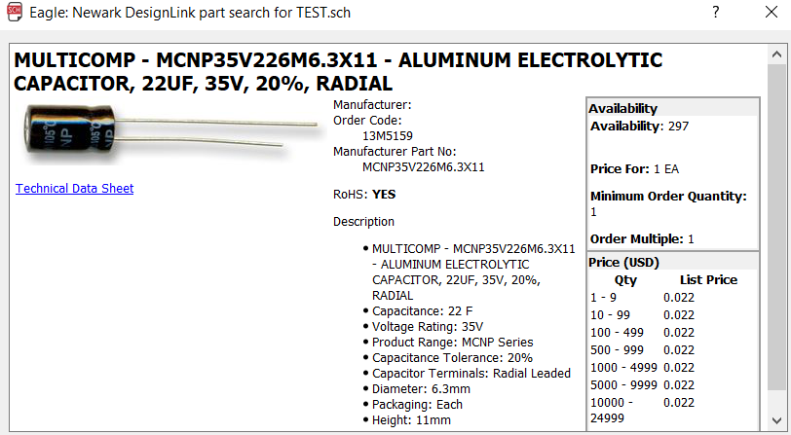
COST in ETUM manufacturing.
18K resistor cost= 0.001
22uF capacitor cost= 0.022

Slide 19
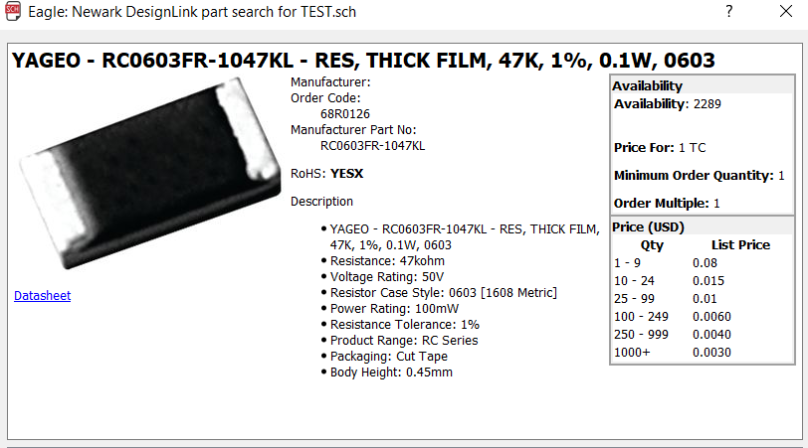
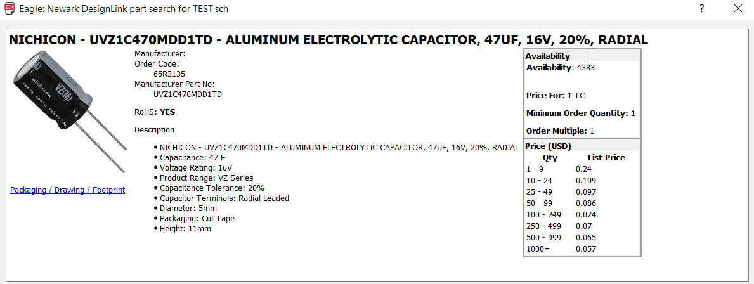
COST in ETUM manufacturing.
47K resistor cost= 0.003
47uF capacitor cost= 0.057

Slide 20
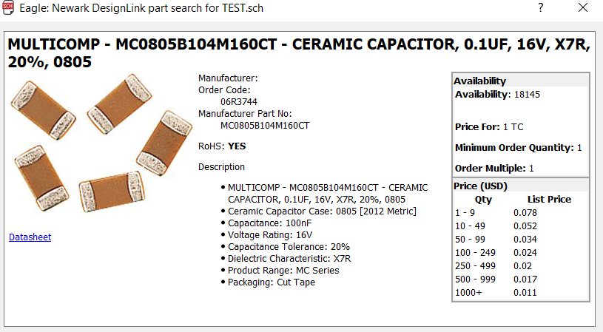
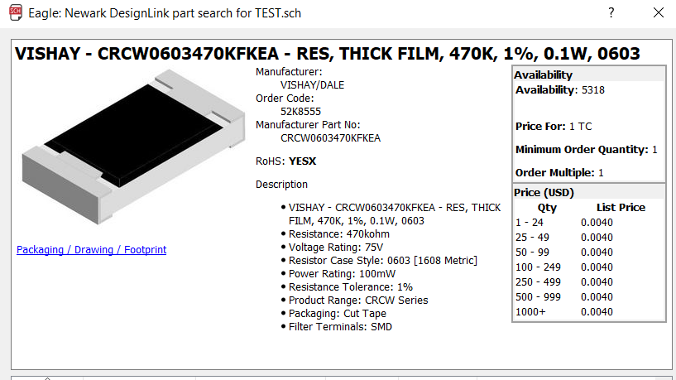
COST in ETUM manufacturing.
0.1uF capacitor cost= 0.001
470K resistor cost= 0.004

Slide 21
COST in ETUM manufacturing.
The link to the website we have referred to buy all these products mentioned above is given below:-
www.newark.com
3000mAh Battery:-
"https://www.alibaba.com/product-detail/Full-Capacity-original-lg-hg2-3000mah_60503919326.html?spm=a2700.7724857.main07.207.2bd13975hQXAYq"
BISS0001 reference link to buy is:-
"https://www.aliexpress.com/item/BISS0001-smd-sop16-1000pcs-lot-sensors-infrared-sensor-ic-Infrared-sensor-signal-processor-We-can-offer/32624873306.html?spm=2114.search0301.4.62.xWAtZB"
ATTINY 24A(SSU) reference link to buy is:-
"https://l.facebook.com/l.php?u=http%3A%2F%2Fwww.microchipdirect.com%2FProductDetails.aspx%3FCategory%3DATtiny24A&h=ATM6nKvu_pvcbGFTBmuNRUAGByPMpY_M7hWHq2KqCkus7rTcDcn-Xq5z2nCcVwqAmaUceGNCP1VwTRRyCmDyiaobLr_Lu3gfhr_9g98PFVk_CxLnTwbSWmDfCHd6nc3aoxv1tuG0jaGUyg"
PIR sensor:-
"https://www.alibaba.com/product-detail/types-of-pir-sensor-pir-sensor_60528709780.html?spm=a2700.7724857.main07.22.2bd1397500RBvO"

Slide 22
ETUM
How far we have reached?
ETUM is designed to detect human presence in a range of about 1m.
For toilet usage monitoring, it is an optimum amount of distance to be measured.
The battery life of the device is about 5 months. To minimize the operating cost,
We have used a 2400mAh battery, but if we want to increase the battery life of the device,
A higher mAh battery can be used (which will increase the cost).
For toilet usage monitoring, ETUM is a perfect device as 5 months is enough to determine
how much the toilet is being used regularly and the future predictions can be made
easily.

Slide 23
ETUM
Future plans
We have a goal to make ETUM more efficient, accurate and cost-efficient. We will work further to increase
The battery life and durability of the device and make it optimum for monitoring toilet usage.
Under proper guidance and with the help of the best minds of India, we have a goal to install ETUM in each and
every Indian house. Swachh Bharat Abhiyaan, an initiative by Respectful PM Narendra Modi, has to be taken
seriously for a clean and beautiful India. And using the best minds of the country in this is the need of the hour.

Slide 24
ETUM
Link to the SolidWorks file, PCB design, ATtiny24A Code and other data is given below:-
https://drive.google.com/drive/folders/0B7fBHyx3akR_MkswR0VGWkpjUFk?usp=sharing

Slide 25


TEAM MEMBERS
Utkarsh Deepak
Nitin Yadav
utkarsh230897@gmail.com
yadav.nitin558@gmail.com
Electronics, ATtiny24A code
Electronics,PCB

Slide 26

THANK YOU!

